Slide 1



Experimental diachronics: Investigating language change and evolution in the lab
James Brand
james.brand@canterbury.ac.nz

Slide 2

Background
Part 1 - Experimental Diachronics
Ways to study language evolution
Insights gained
Issues with these approaches
An experimental approach
Padraic Monaghan
Kenny Smith

Slide 3




Background
Part 2 –Sensorimotor basis of concepts
If there is time…
Megastudy dataset of sensorimotor norms
Why they are interesting
Language change applications?
Dermot Lynott
Louise Connell
James Carney
Marc Brysbaert

Slide 4
Background
Darwin (1837)

Slide 5
Background
Schleicher (1863)

Slide 6
Background
Gray et al., 2010

Slide 7
Background
mum
μαμά
mama
maman
mamá
māmā¹
butterfly
πεταλούδα schmetterling
papillon
mariposa
pūrerehua
¹kowhaea

Slide 8
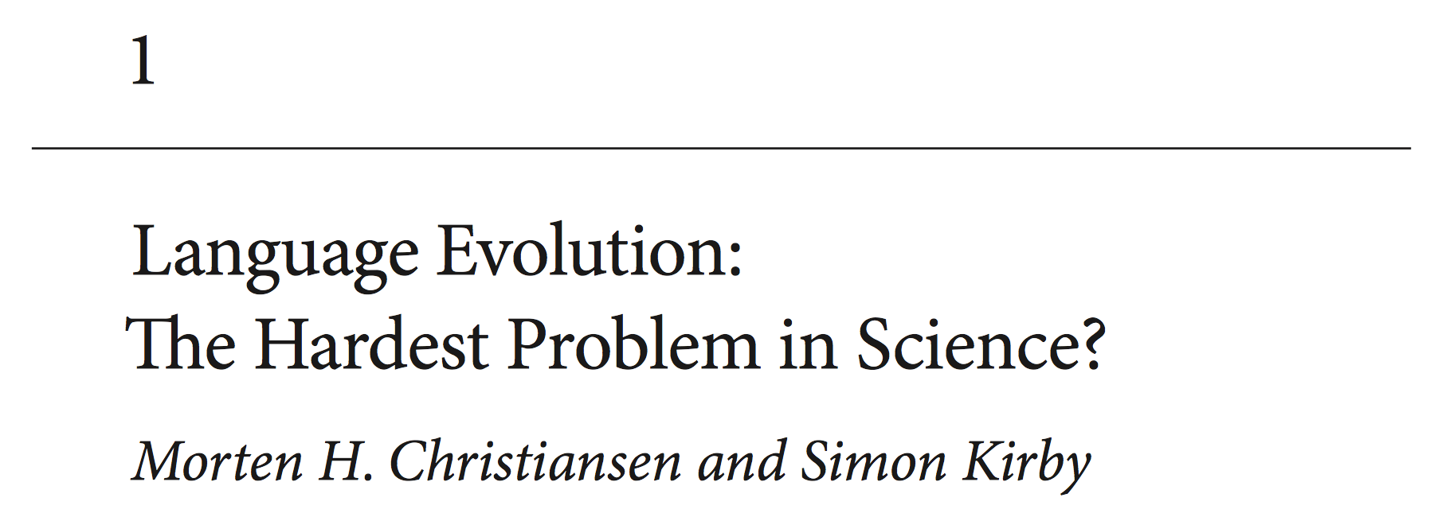
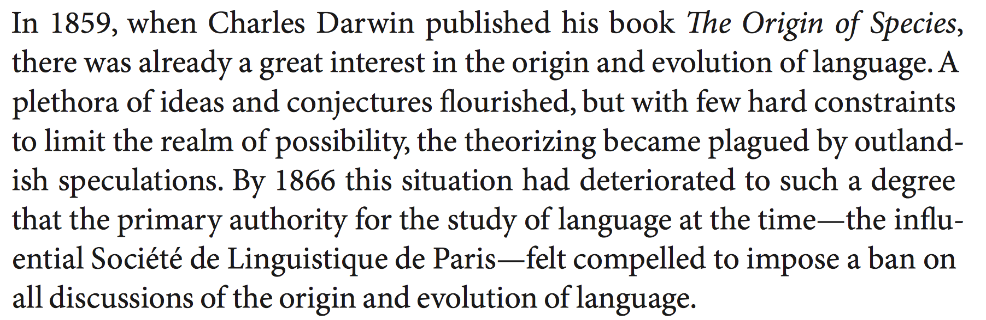
Background
Christiansen & Kirby (2003)

Slide 9
Background
https://startlediguana.files.wordpress.com/2013/10/boule_skulls.gif

Slide 10
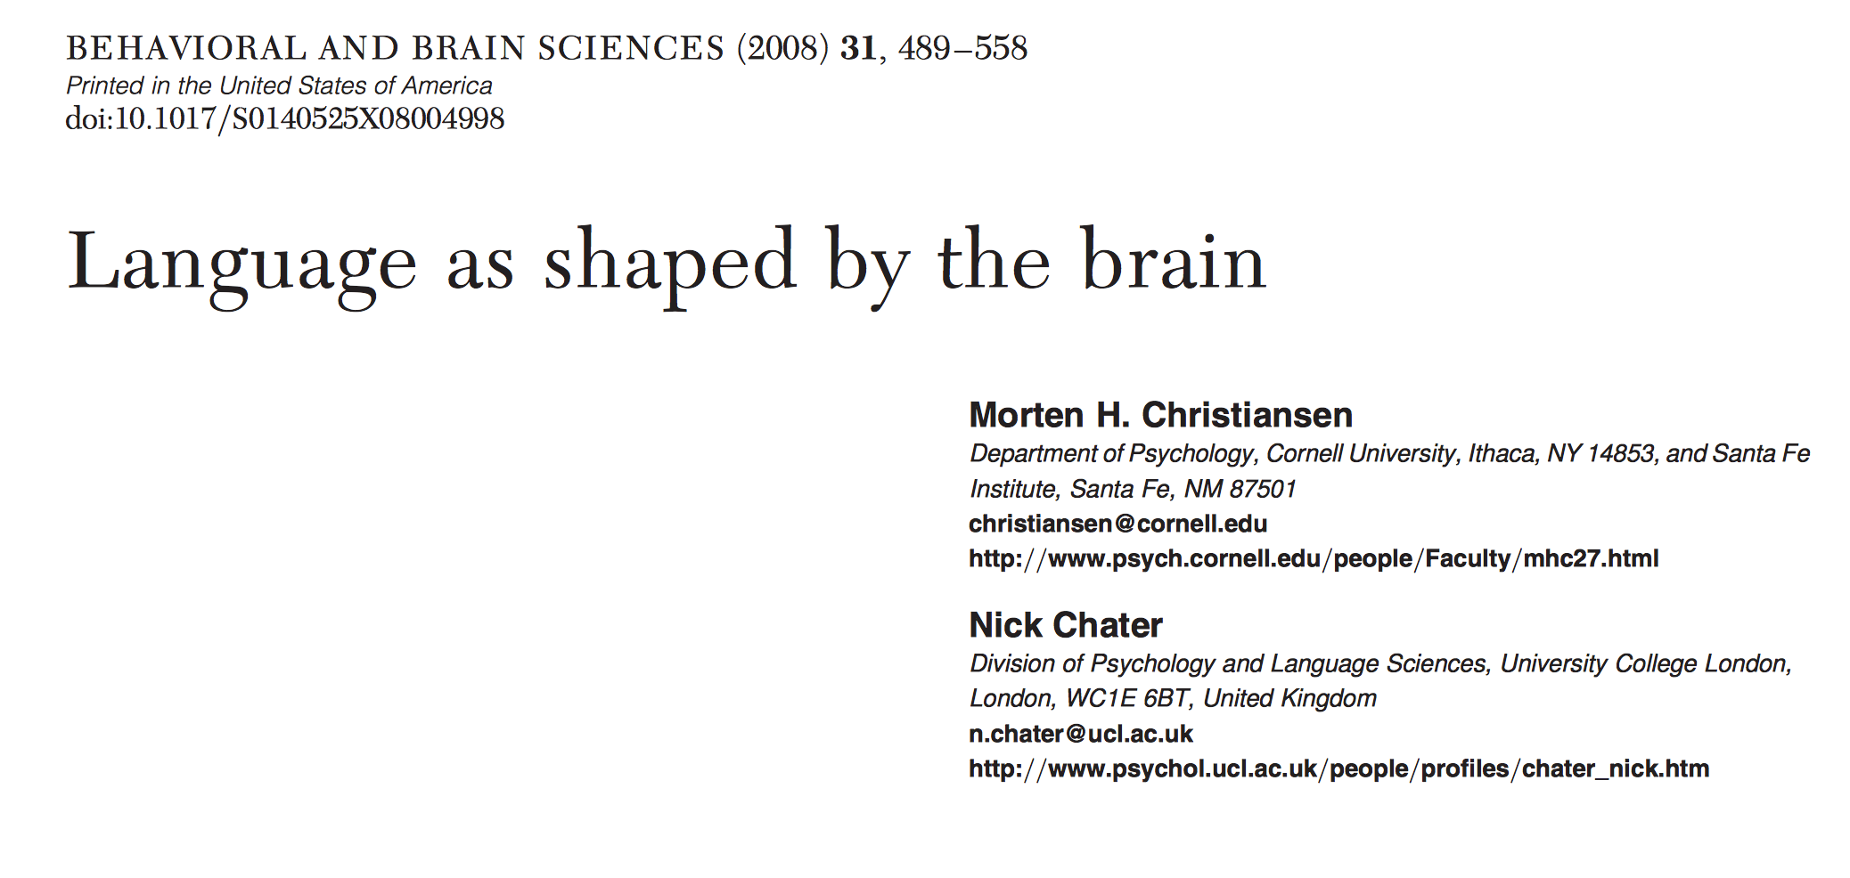
Background
Christiansen & Chater (2008)

Slide 11
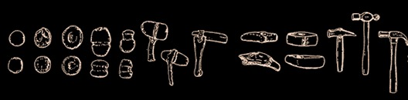
Background
Basalla (1988)

Slide 12
Background
http://www.replicatedtypo.com/iterated-learning-using-youtube-videos/6093.html

Slide 13
Background
lumonamo
nelu
kapihu
kinahune
kanehu
humo
lahupine
namopihu
lahupiki
moki
kalu
nane
luneki
mola
lamuna
lanepi
pihukimo
mokihuna
kilamo
pilu
luki
kahuki
neki
namola
neluka
pinemohu
lumoka
Kirby, Cornish & Smith (2008)

Slide 14
Background
Kirby, Cornish & Smith (2008)

Slide 15
Background
Ic ne secge (Beowolf, 900)
Ic ne sege noht
(Ormulum, 1100)
I seye not
(Chaucer, 1400)
I doe not say
(Shakespeare, 1600)
I don’t say
(Woolf, 1900)

Slide 16
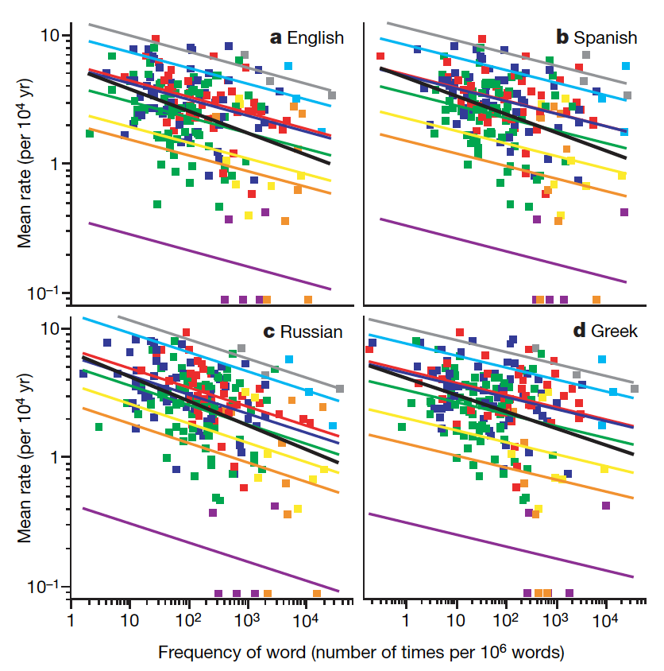
Background
Pagel, Atkinson & Meade (2007)

Slide 17
Background
Predictor | Less stable | More stable | Source
Frequency | low | high | Pagel et al (2007)
Length | long | short | Monaghan (2014)
Age of acquisition | late | early | Monaghan (2014)
Number of Synonyms | high | low | Vejdemo & Hörberg (2016)

Slide 18
Background
But…
Only < 200 fundamental vocabulary items used
Lexical predictors assumed to be stable across time
Rate of replacement calculation very coarse
Does not detect more subtle changes in the words
Complexities of working with this type of data

Slide 19
Experiment
Experimental approach…
Use iterated learning paradigm to model cultural transmission of language across generations of learners
Carefully control for variables of interest with artificial language design
Use novel statistical analyses to classify the type of changes produced
Investigate evolution from the origin

Slide 20
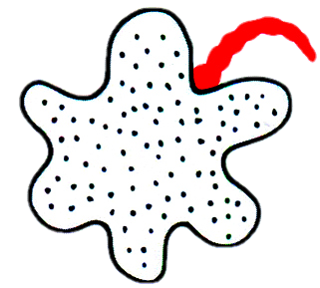

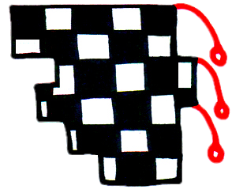
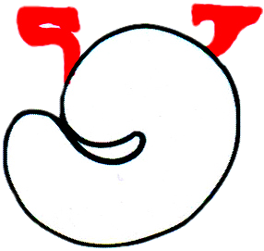
Experiment
Stimuli
12 non-words (length = 6 letters) generated from 8 consonants and 5 vowels, CVCVCV
No duplicated syllables within a word
Each word maximally distant from others
Each word mapped onto unique meaning
gahemi
hekipo
muhego
lenoga

Slide 21
Experiment
Design
4 chains of 8 participants (generation)
Frequency conditions – low, med, high
4 words in each condition
Training stage:
Participants learn 12 form-meaning mappings
low – 3 exposures per word
med – 9 exposures per word
high – 18 exposures per word

Slide 22
Experiment
Design
Testing stage:
Shown just the meaning and asked to generate the word they think mapped onto it
Take the output from one generation and then train the next generation on that language, iterate over 8 generations
Filter out any duplicate words (see Kirby et al 2008)
Maintain frequency conditions

Slide 23
Experiment
Analysis
Error:
Levenshtein distance (LD)
How similar is the input word to the output word
g a h e m i
g a h e w u
0 0 0 0 1 1
LD = 2

Slide 24
Experiment
Analysis
Replacement/adjustment:
MCMC sample of 10,000 potential words
Calculate critical threshold (CT) between these words and each input word as estimate of random production distance
If recall word LD is < CT, adjustment
If recall word LD is > CT, replacement
If recall word == input word, accurate

Slide 25
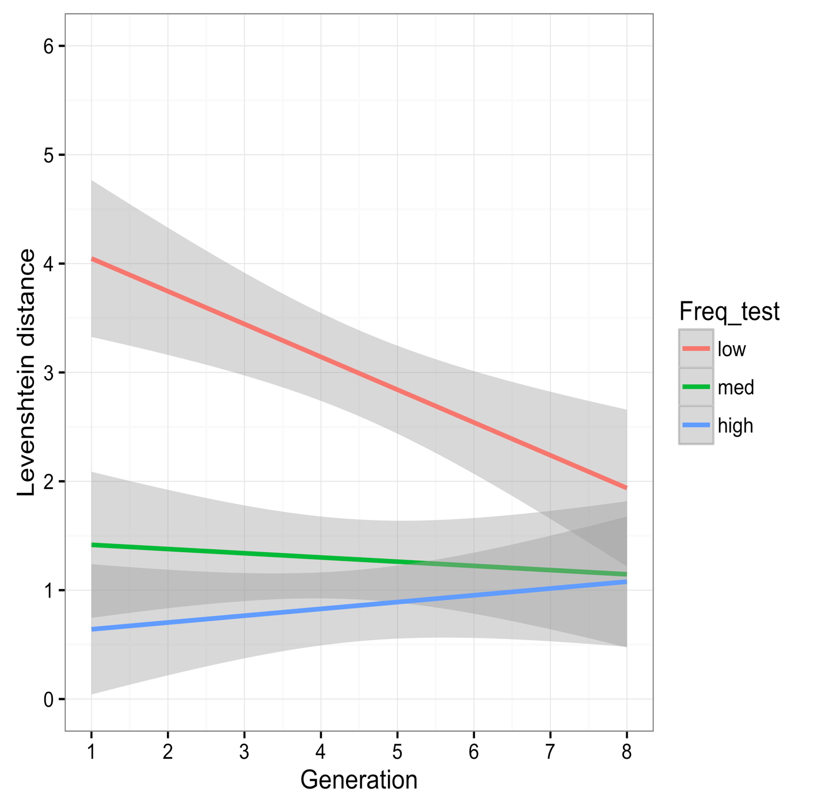
Experiment
Results
Frequency | Generation 1 | Generation 7
low | giloku | mihewu
low | howuna | mihuge
low | kugawe | napiwa
low | lomapi | nokiwa
med | nakilu | lilipe
med | wapohe | lamupo
med | muhego | hewino
med | punima | wopehu
high | henumi | punima
high | gakulo | logopi
high | nipewa | henumi
high | mehapu | gakulo

Slide 26
Experiment

Slide 27
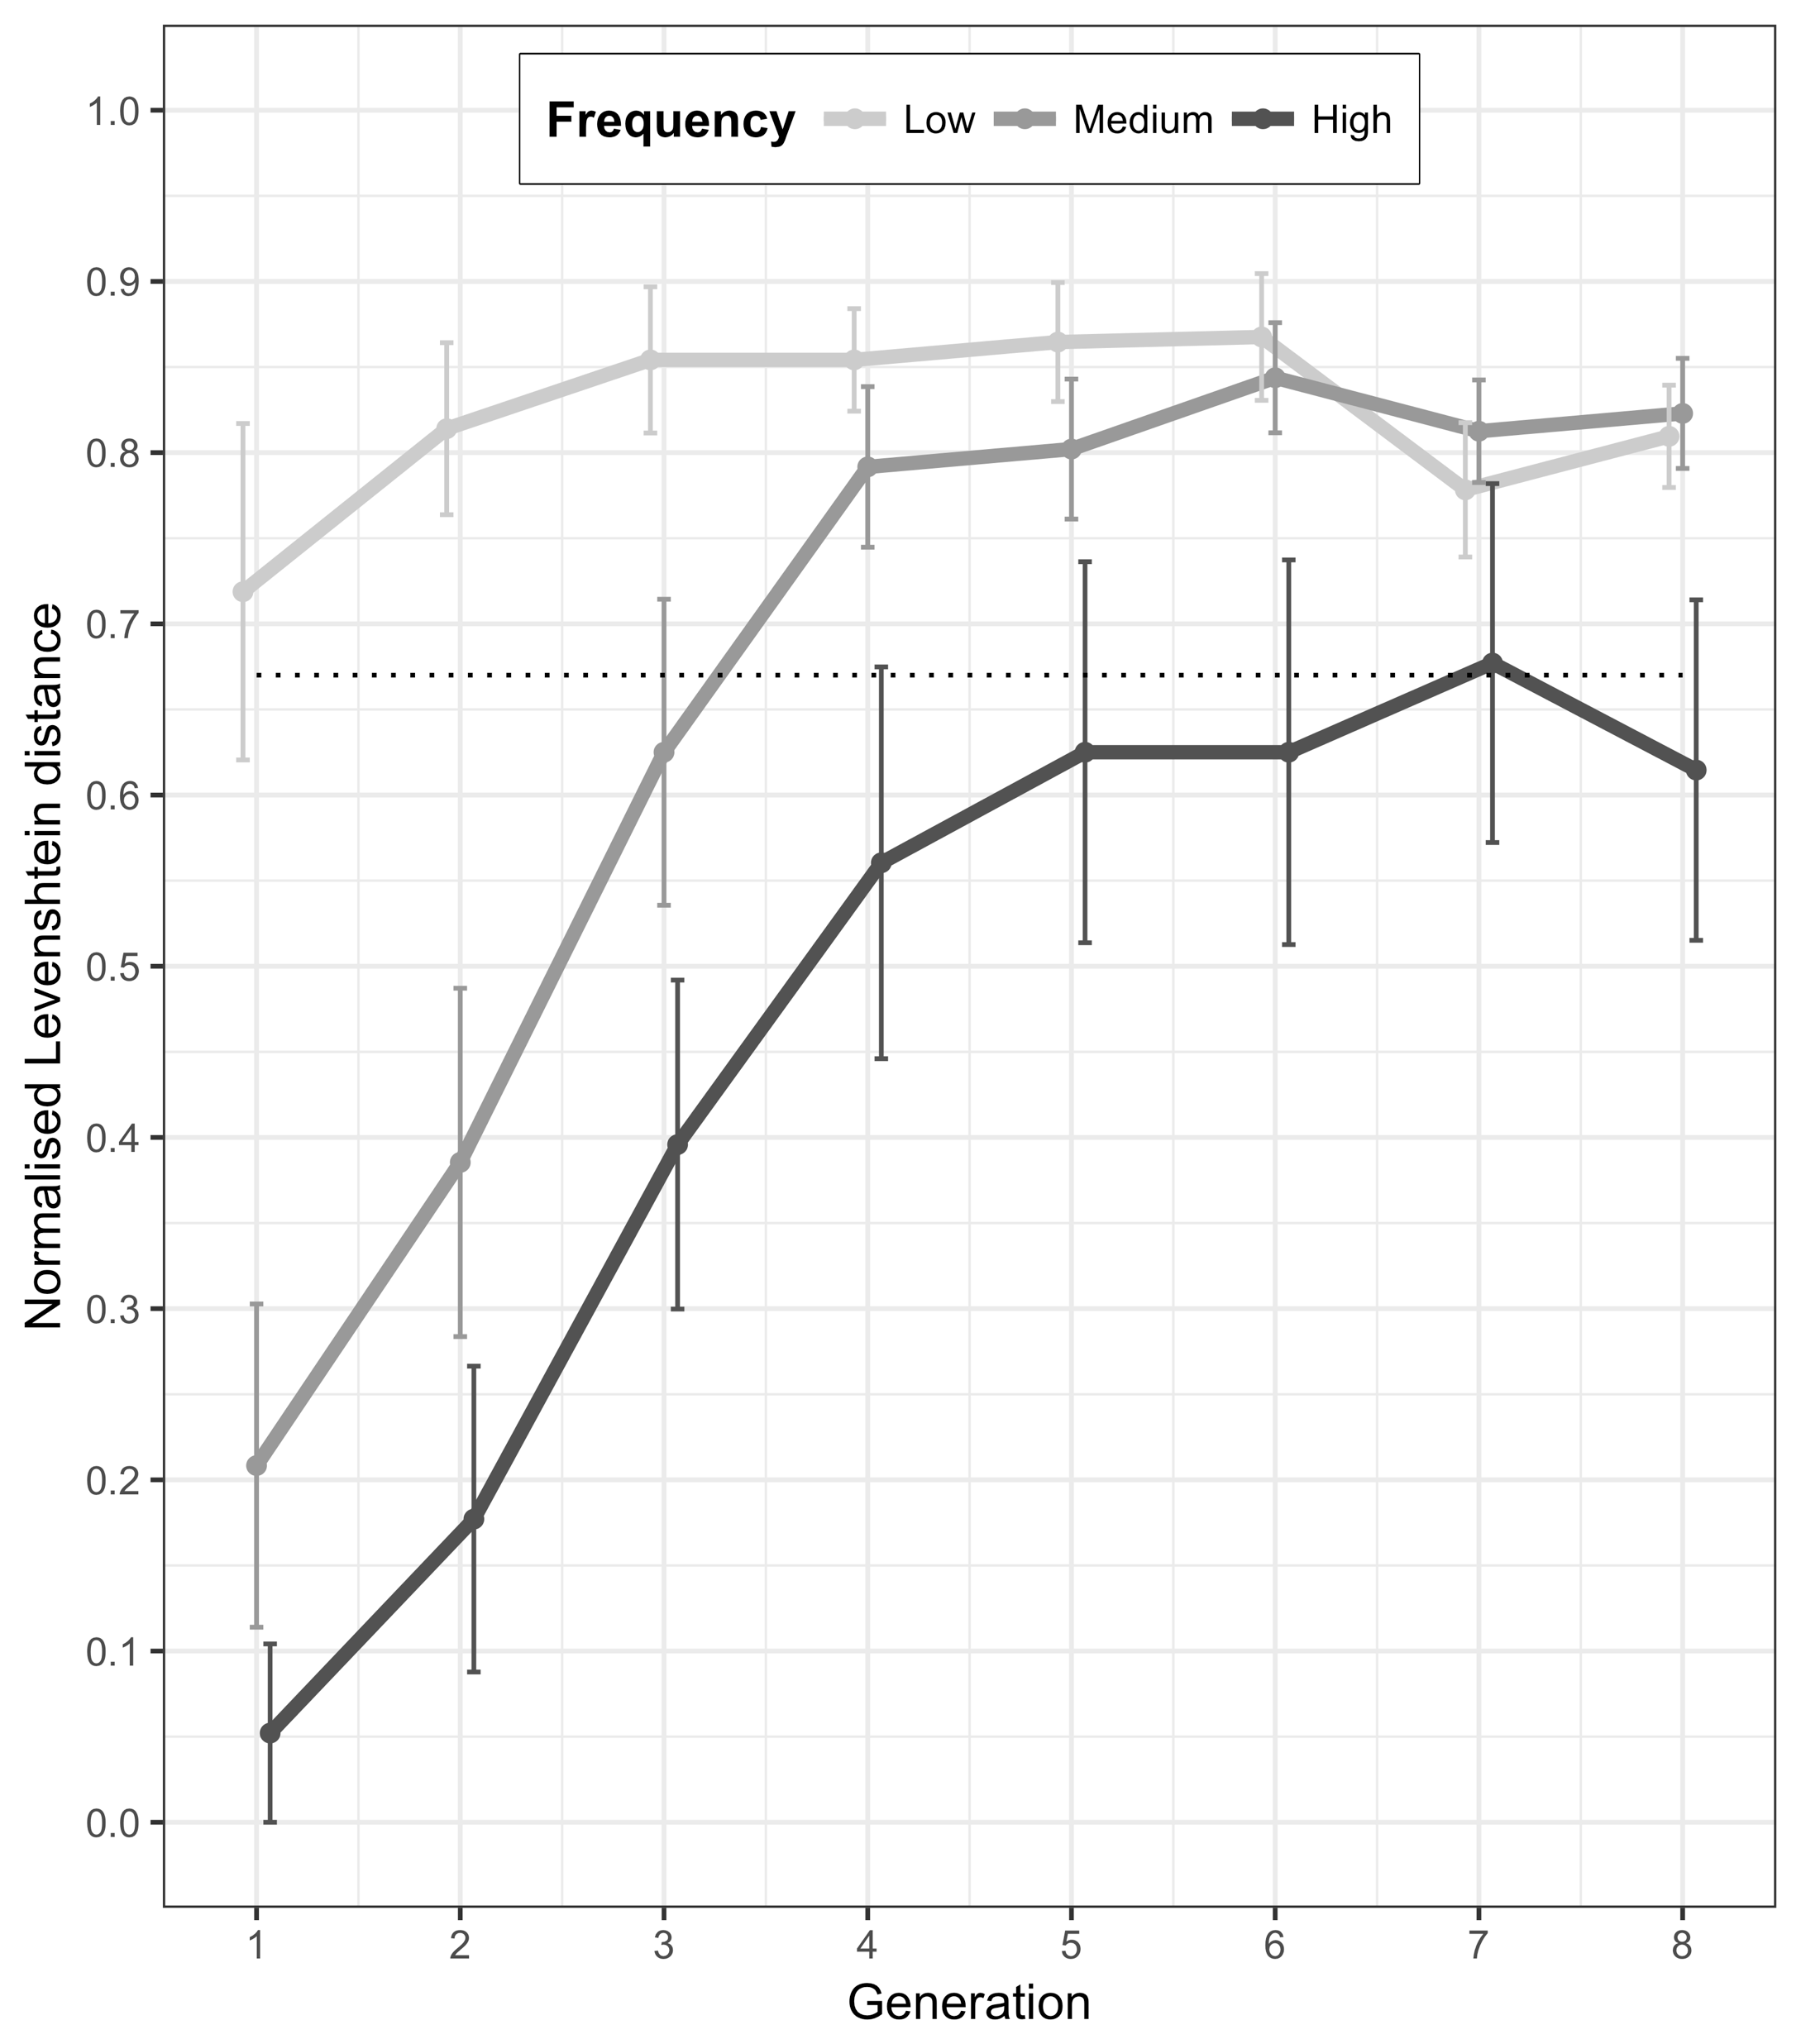
Experiment

Slide 28
Experiment
Conclusion
Experimental diachronics can be used to assess change and also stability in a language over the course of transmission
Can offer the researcher more control over variable of interest
Can provide more robust evidence than results derived from corpus based methods (alongside them, not in isolation)

Slide 29
Experiment
Future directions
More statistical power… 4 chains is not enough (MTurk, see Beckner et al., 2017)
Sound change, not orthographic change
Extending beyond noun categories
Language in interaction, incorporating dialogues and moving away from isolated learners

Slide 30
Sensorimotor norms
Part 2
Sensorimotor norms for the human conceptual system…

Slide 31
Sensorimotor norms
“If it looks like a duck, and quacks like a duck, we have at least to consider the possibility that we have a small aquatic bird of the family Anatidae on our hands”
Douglas Adams
Dirk Gently's Holistic Detective Agency

Slide 32
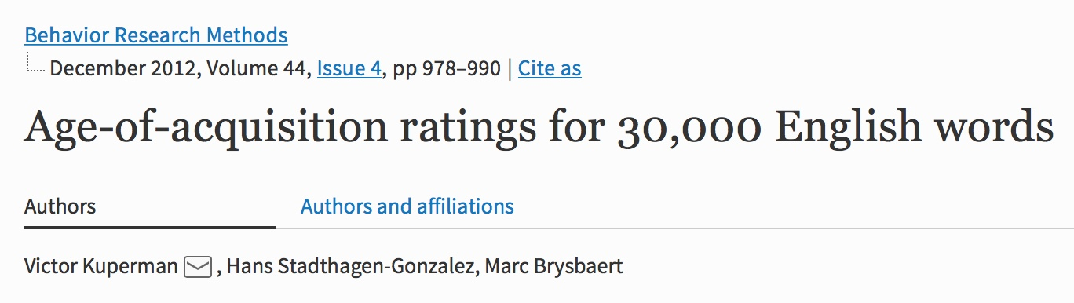
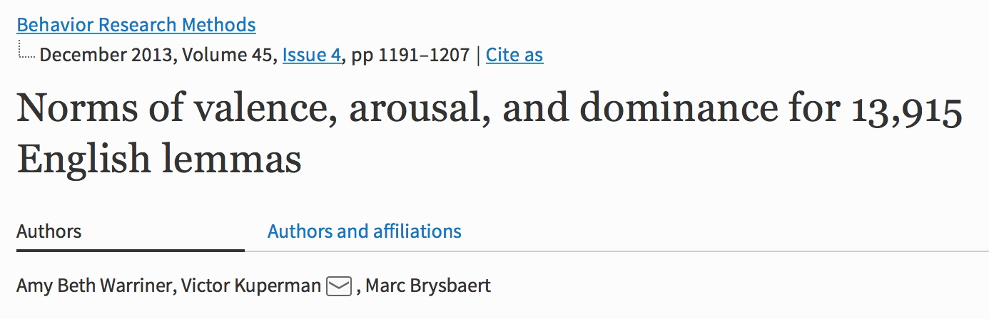
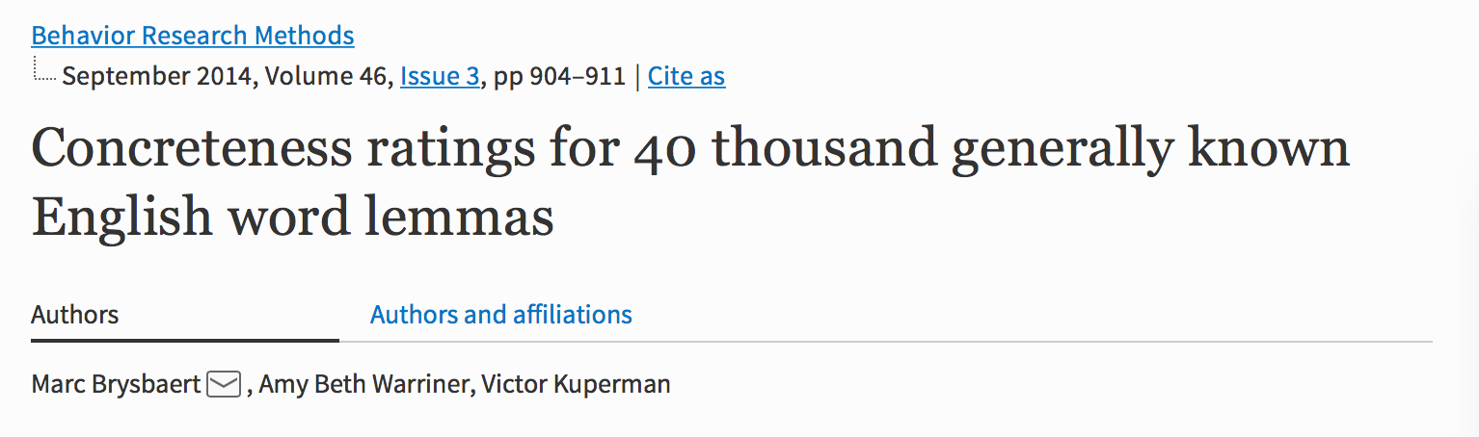
Sensorimotor norms

Slide 33
Sensorimotor norms
DUCK
Concreteness = 4.86 (SD = 0.52)
On a scale of 1-5

Slide 34
Sensorimotor norms
THINKING
Concreteness = 1.96 (SD = 1.19)
On a scale of 1-5

Slide 35
Sensorimotor norms
Sensorimotor norms
Sensory and motor ratings for ~40,000 concepts using MTurk
Each concept has ~19 participant ratings
Each participant rates 48 words
Overall, N = 31,851
11 dimensional dataset (6 sensory, 5 motor) ratings for each concept

Slide 36
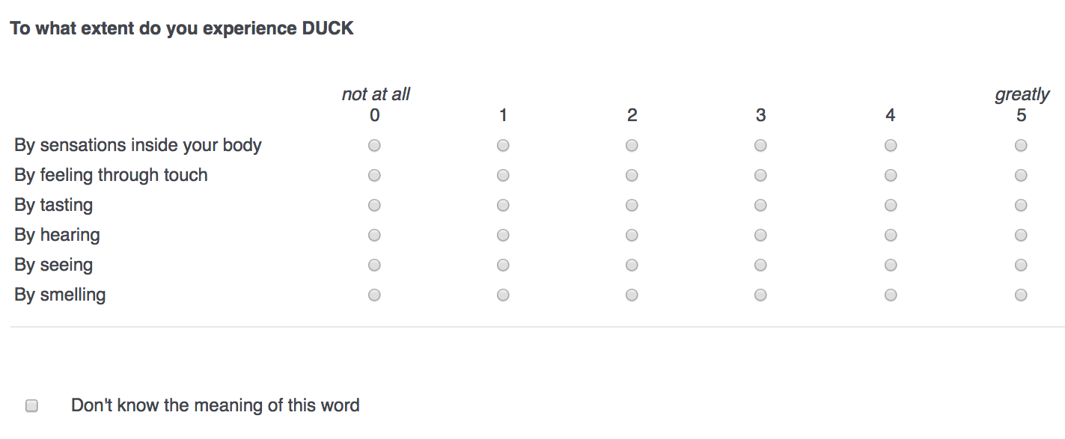
Sensorimotor norms

Slide 37
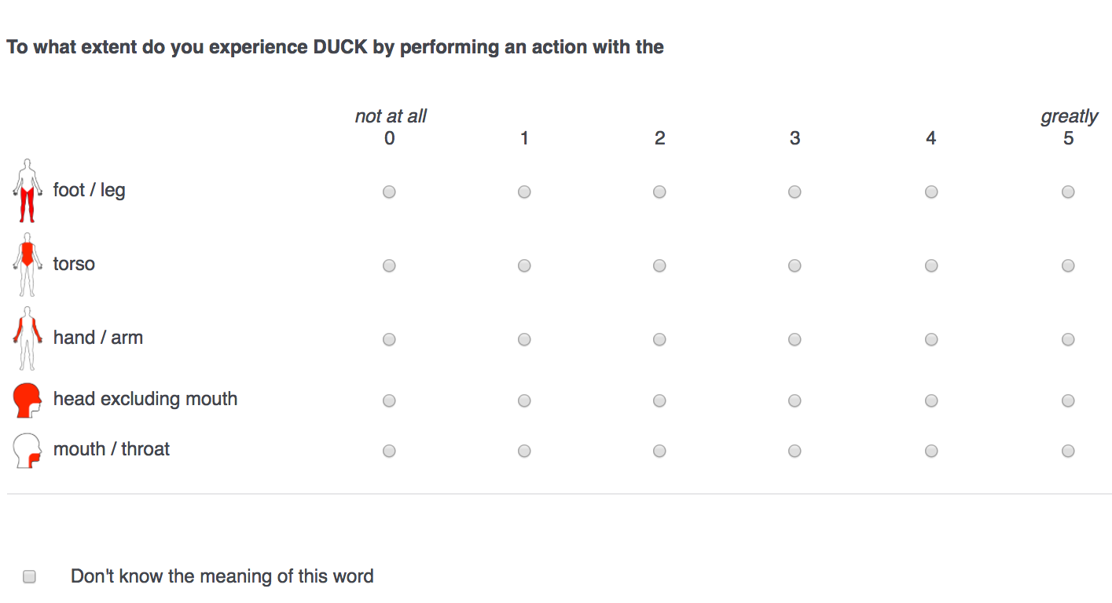
Sensorimotor norms

Slide 38
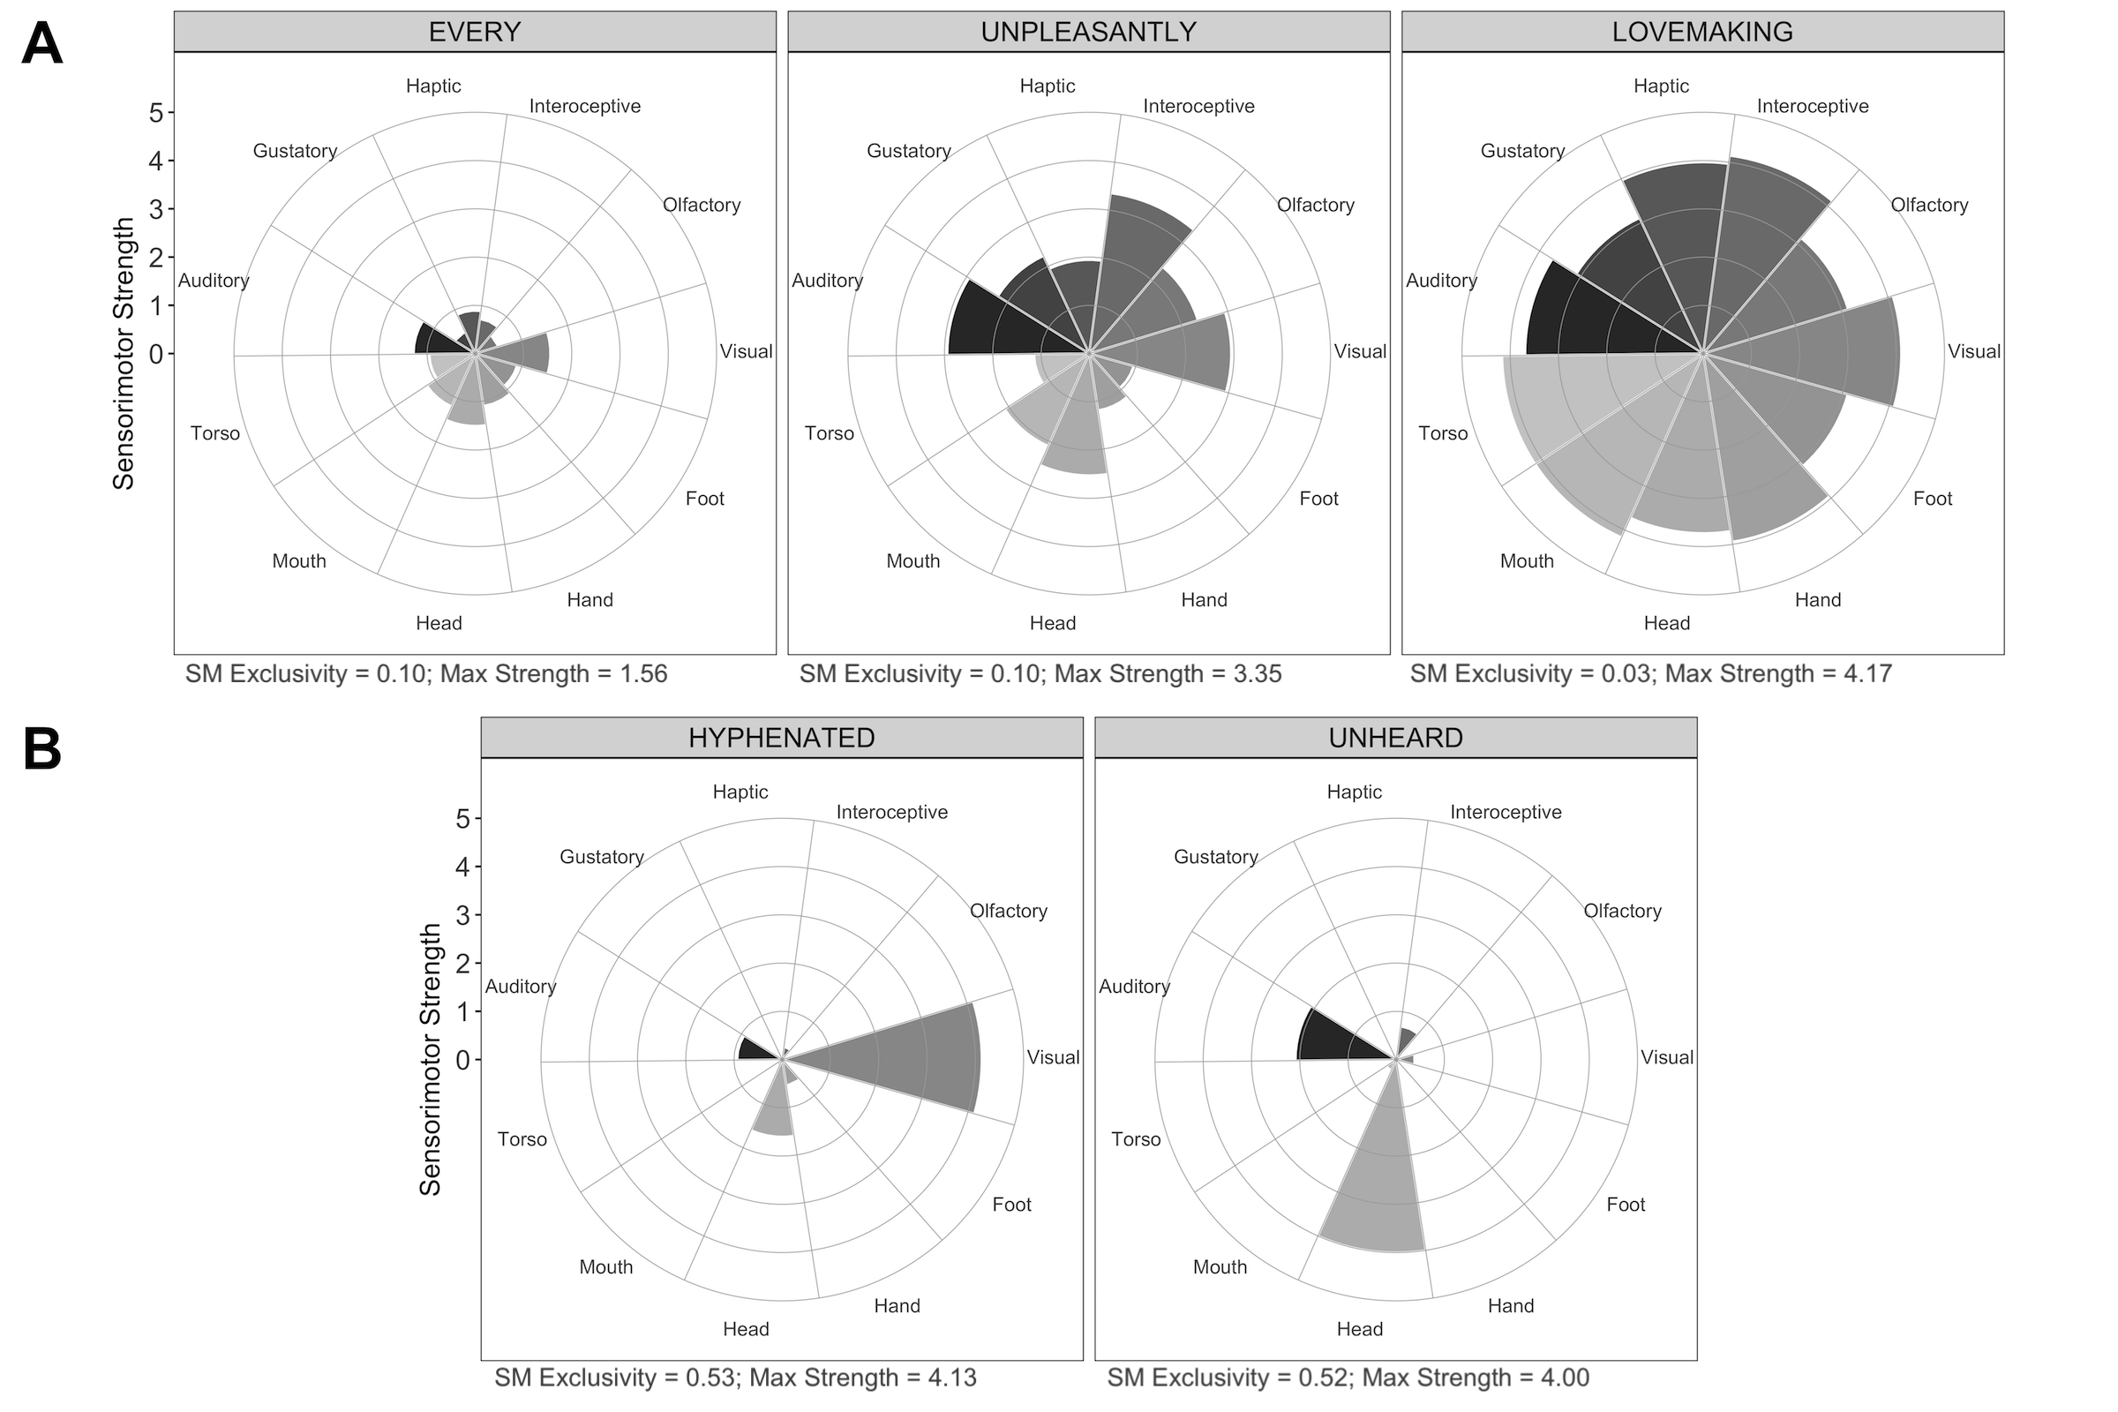
Sensorimotor norms

Slide 39
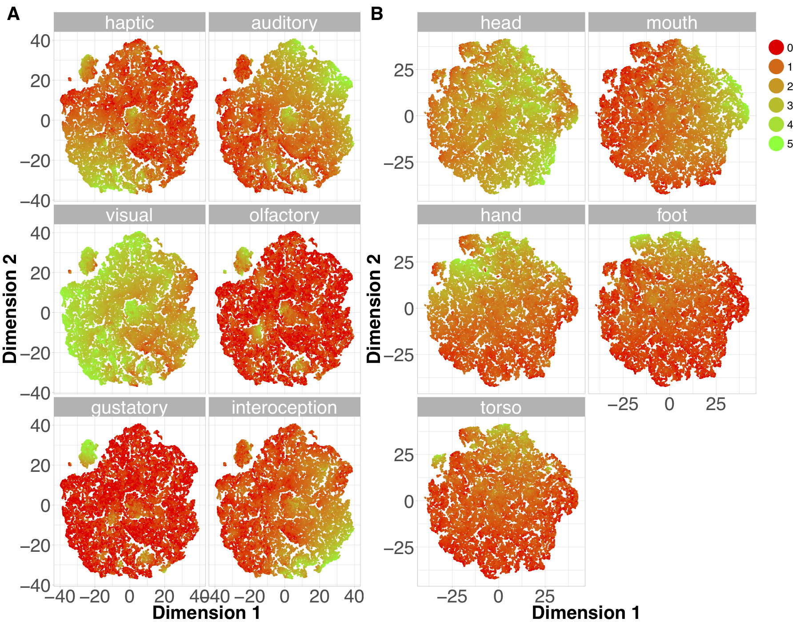
Sensorimotor norms

Slide 40
Sensorimotor norms

Slide 41
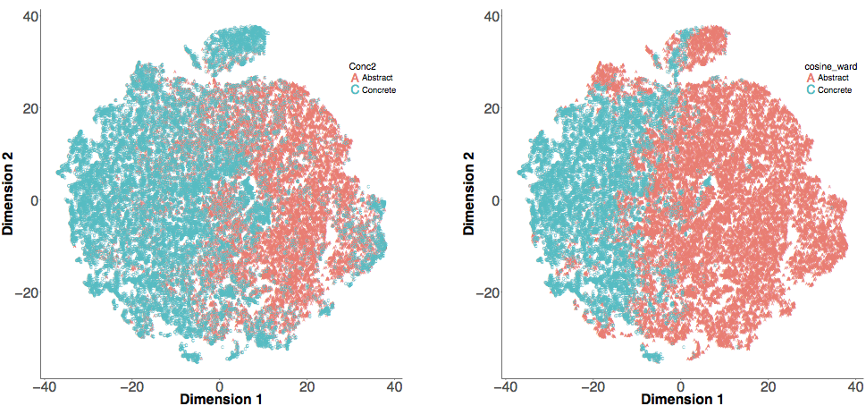
Sensorimotor norms

Slide 42
Sensorimotor norms
Sensorimotor norms utility
Can explain additional Lexical Decision time variance above and beyond basic predictors
More sensitive and multidimensional measure, that provides a percepetually grounded framework for concrete/abstract distinctions
Application to language change hypotheses?

Slide 43
Thanks
Tēnā koutou

